Slide 1
What Every Speech-Language Pathologist Needs to Know about the Training, Use and Supervision of SLP Assistants:
Janet Deppe, MS CCC-SLP Director, State Advocacy March 23, 2013

Slide 2
Overview
ASHA State Liaisons
Definition of SLPAs and Support Personnel
ASHA’ s History with Support Personnel
Speech-Language Pathology Professional Summit
Education, Regulation, Use and Supervision of SLPAs
ASHA’s Scope of Practice for SLPAs
Practice Resource Project and Use of Support Personnel
ASHA Documentation: State by State Trends
Reimbursement
ASHA Web Resources
State examples
ASHA Affiliates Program
Scenarios

Slide 3
State Outreach Map

Slide 4
ASHA State Outreach Model
 Northeast Region – MA, NH, VT, NY, RI, CT, NJ, PA, DE, MD, OH, ME, DC
Susan Adams sadams@asha.org 800-498-2071, ext. 5665
 South Region – VA, WV, KY, NC, TN, SC, GA, FL, AL, MS, LA, AR
Janice Brannon jbrannon@asha.org 800-498-2071, ext. 5666
 Central Region – ND, SD, NE, KS, OK, TX, MO, IA, MN, WI, IL, IN, MI
Janet Deppe jdeppe@asha.org 800-498-2071, ext. 5668
 West Region – HI, AK, CA, OR, WA, NV, ID, UT, AZ, NM, CO, WY, MT, Overseas
Eileen Crowe ecrowe@asha.org 800-498-2071, ext. 5667
Notes:
Our job is to assist state within our regions with legislative and regulatory issues, association issues including leadership succession and volunteer recruitment and provisions of ASHA resources, trends, and national perspective. We also want to serve as your “go to” person at the National Office so that you as leaders and members won’t have to wait or be referred around the office , but will be able to contact us directly ( direct line is on my business card) and if we can’t answer your questions, we will find the correct person in the office who can.

Slide 5
Definition of a Speech-Language Pathology Assistant (SLPA)
Speech-language pathology assistants are support personnel who, following academic and/or on-the-job training, perform tasks prescribed, directed, and supervised by certified speech-language pathologists.
Definitions of SLPAs and other support personnel vary in states
Speech-language pathology assistants have been used and regulated by many states since the 1970s. ASHA has had guidelines for the use of support personnel since 1969
Notes:
How do you define SLPAs? How do they differ from paraprofessionals? Do you use paraprofessionals in education or other practice settings? Do you think SLPAs should be used and if so how do you think they should be defined?

Slide 6
ASHA History with SLPAs
Speech-language pathology assistants have been used and regulated by many states since the 1970s. ASHA has had guidelines for the use of support personnel since 1969
1967- ASHA created the Committee on Support Personnel
1969 – the LC approved the Guidelines for the Communicative Aide
1979- the Ethical Practice Board issues an Ethics statement on support personnel
1981- the Guidelines for Employment and Utilization of support personnel was developed
1990-91- the 1967 committee sunsetted and the Task force on Support Personnel was created
1992, 1994, 1995 – ASHA policy documents on support personnel created including the technical report, position statement and guidelines

Slide 7
ASHA History with SLPAs
1994- the LC passed a resolution supporting the establishment of credentialing support personnel
1996-200 Credentialing process developed
2002- Approval process for SLPA programs
2003 -registration for SLPAs established, LC resolution discontinued the program
2004- Position statement revised
2007- SLP summit discussed consideration of a continuum and credentialing
2011 SLP Professional Service Continuum Summit

Slide 8
Speech-Language Pathology Service Continuum Summit
Persistent shortage of SLPs particularly in education settings has led to the rise in establishment of competing standards
California: Communication Development Specialist
Minnesota: Academic Language and Behavioral Strategist
Alternative standards allow lesser qualified individuals to practice independently
ASHA’s BOD approved the development of a service delivery continuum summit which would identify practitioner roles, education, training and competency requirements.
Notes:
We were concerned about two things:
The states interpretation of IDEA, 2004, which allowed the states the rights to set practice standards ( Prior IDEA rules required all states to have the highest qualified provider requirements set the state standard. This meant that states could now consider lowering the standard for SLP independent practice from an MA to a BA (Texas was one of the states that tried to reduce the standard unsuccessfully from an MA to BA several years ago)
We were also concerned that states would establish competing standards (See above)

Slide 9
Speech-Language Pathology Professional Summit
The SLP Professional Summit was created to bring together ASHA members from different geographic locations and academic backgrounds, who practice in a variety of settings to develop recommendations for a service continuum
The summit was held July 22-23, 2011 in Alexandria VA.
Notes:
70+ attendees representing SLPs who hire and supervise SLPAs
Practicing SLPAs
State Education Advocacy Leaders
DOE officials including state education consultants
Undergraduate and graduate training program representatives
BOD members
ASHA Staff
Kathy Mayes attended from South Dakota

Slide 10
Recommendations from the SLP Professional Summit
Six recommendations were approved by attendees and sent to ASHA’s BOD for consideration:
ASHA should develop a shared lexicon
ASHA should develop and publish a framework that articulates the range of acceptable practice across the different service provider levels
ASHA should consider developing a comprehensive assessment consistent with its commitment to inclusion- A national examination ( for SLPAs) represents one such option
Notes:
2. Everyone would use the same terminology to describe SLPs and support personnel
3. Here is the rough draft of a framework that was developed by summit participants

Slide 11
Rudimentary Framework Model: SLP Summit 2011
 | Credentials | Clinical Exp | Supervision | Scope of Practice
Paraprofessional | • HS diploma • Associate: not specific to SLP | None required? | Acts only under direct, continuous supervision | Executes explicit directions given by SLP (i.e., follows a treatment plan, helps with paperwork, prepares materials, etc.)
SLPA | • Associate: SLP • Bachelor’s in speech and hearing • Bachelor’s w/req. coursework •Bachelor’s followed by certificate • Competency exam (TBD) | Stipulated number of clinical hours | Acts under regular or periodic—but not continuous— guidance of supervisor | Exercises initiative in pursuit of SLP- directed and supervised assignments (i.e., follows a treatment plan, reports, and provides feedback to the SLP)
SLP | • Master’s in speech-language pathology CCC-SLP | 400 clock hours? | May serve as supervisor | Independent practice may include supervision of paraprofessionals and SLPAs
Doctoral | • PhD or clinical doctorate | To be determined | To be determined | To be determined

Slide 12
Recommendations from the SLP Professional Summit
ASHA should
develop model state regulatory language for the regulation of SLPAs
develop principles and protocols of effective supervision for both supervisors and those who require and benefit from supervision
form a task force, in cooperation with the Council of Academic Programs, to study the continuum of academic preparation and determine how the continuum can best support SLPA and SLP preparation
Notes:
Later in the presentation I will discuss the recommendation approved by the board and the results of those activities

Slide 13
Speech-Language Pathology Professional Summit
Results and recommendations from the summit are posted on the ASHA web site at: www.asha.org/SLP/2011-SLP-Professional-Summit/

Slide 14
Education of SLPA
State agencies (licensure boards) currently regulating support personnel have training requirements that range from a high school diploma to a baccalaureate degree plus graduate credit hours
NEW: ASHA currently recommends completion of an associates or bachelor’s degree from an accredited training program
Following the Professional Summit in July, participants recommended that ASHA develop additional resources for SLPAs including guidance on the education required to serve as an assistant

Slide 15
Training of SLPA
Training varies from state to state:
Some require additional fieldwork beyond the degree requirement;
others simply require on the job training post high school
other states may employ support personnel that are unregulated and have no academic or training requirement

Slide 16
Regulations of SLPAs in states
States regulate assistants through:
Department of Health licensing/certification/registration
Department of Education certification/licensing
Some restrict practice to education settings only (KY)
At least 10 states do not regulate SLPAs including WI
Many but not all states require continuing education for assistants ranging from 15 hours per year in KY to 5 hours per year in MD and 4 per year in SC.
Some mirror continuing education requirements in the state for SLPs 20/2 (FL, NJ and TX), and 10/1 (OK).

Slide 17
Use of SLPAs
SLPAs are used in a variety of settings including:
Schools
Hospitals
Private Settings
Early Intervention
Other
Notes:
Majority used in school settings; Audiology assistants in industry ( hearing conservation) and the VA

Slide 18
Supervision of SLPAs
The amount and type of supervision required should be based on:
skills and experience of the SLPA
the needs of patients/clients served
the service setting
the tasks assigned
other factors

Slide 19
Supervision of SLPAs
ASHA suggests 30% weekly (at least 20% direct) for the first 90 workdays and 20% (at least 10% direct) after the initial work period.
Direct supervision means on-site, in-view observation and guidance by an SLP while an assigned activity is performed by support personnel
A separate guidance document on supervision is currently under development

Slide 20
Who can Supervise SLPAs?
ASHA suggests that an SLPA supervisor be a speech-language pathologist certified by ASHA and licensed by the state (where applicable) who has been practicing for at least 2 years following ASHA certification
ASHA also recommends that the SLP supervisor complete at least one pre-service course or continuing education unit in supervision.

Slide 21
ASHA’s Ad Hoc Committee for Scope of Practice for SLPAs
Recommendation from the 2011 Summit: Develop Scope of Practice Policy for SLPAs
ASHA appointed an Ad Hoc Committee to develop SOP for SLPAs
The following summarizes the qualifications of the SLPA approved by the BOD as policy of the association:
Completion of BA degree in CSD or AA degree in an SLPA program or equivalent course of study
Completion of 100 hours of clinical practice within the education and training program or (supervised field work experience) on the job
Adherence to SLPA responsibilities/policies and refrain from tasks that are the sole responsibility of the SLP
Adherence to state licensing and regulatory rules governing the practice
Completion of required continuing education and or professional development activities
Guidance is also provided for allowable tasks, ethical considerations and SLP supervisory role
Notes:
New items in the scope of practice for SLPAs have been proposed-
1. Reduction from three to two for the number of full time SLPAs that may be supervised. This number is for full time equivalent. The committee was most concerned about the time required for supervision and felt, for example, that you could still have four individual SLPAs as long as they don’t take up more than 2 full time equivalent time wise.
2. Addition of telepractice as one of the practice settings.
The scope has been sent out for select peer review and will go out for wide spread peer review as soon as the select peer review ends. ASHA’s Board of Directors will review comments from peer review. The final version of the scope will be posted on the ASHA web site by the end of the year and will become practice policy of the association

Slide 22
Recommended Tasks of SLPAs
Assist speech-language and hearing screenings (without interpretation)
Assist with informal documentation as directed by the speech-language pathologist
Follow documented treatment plans or protocols developed by the supervising speech-language pathologist
Document patient/client performance (e.g., tallying data for the speech-language pathologist to use; preparing charts, records, and graphs) and report this information to the supervision speech-language pathologist

Slide 23
Recommended Tasks of SLPAs
Assist the speech-language pathologist during assessment of patients/clients
Assist with clerical duties such as preparing materials and scheduling activities as directed by the speech-language pathologist
Perform checks and maintenance of equipment
Support the supervising speech-language pathologist in research projects, in-service training, and public relations programs

Slide 24
Recommended Tasks of SLPAs
Assist with departmental operations (scheduling, record keeping, safety/maintenance of supplies and equipment)
Collect data for monitoring quality improvement
Exhibit compliance with regulations, reimbursement requirements, and speech-language pathology assistant's job responsibilities

Slide 25
Support Personnel Use
17, 195 in use*
* figure obtained from ASHA dues renewal survey in which certified ASHA members are asked whether or not they supervise support personnel. Suspect the number in use is much higher than reported
Notes:
Recent surveys suggest that ASHA certified SLPs supervise approximately 17,000 SLPAs

Slide 26
Medicare Reimbursement
Medicare policy currently does not recognize SLPAs, regardless of the level of supervision and does not reimburse for speech-language pathology assistant services. Private insurers may cover licensed or registered speech-language pathology assistants. One must query each payer to verify coverage.
Notes:
Does anyone know of any insurers in SD that reimburse for SLPA services?

Slide 27
Medicaid Reimbursement
Medicaid reimbursement for SLPA services varies. About 10 states currently allow it in their state plan. Some states addressing the shortage of SLPs allow for SLPA billing in education settings. There does not seem to be a pattern in the states.
Oklahoma Example-Rules currently prohibit Medicaid billing for services provided by SLPAs and student clinicians.
Notes:
In Oklahoma, state rules specify that an SLPA can bill Medicaid for services only if the SLPA is employed by an SLP. School-based SLPAs can’t participate in Medicaid because they are employed by a school or district.
The OK. SLH Association collected info. from ASHA and other states on Medicaid policies that allow billing by SLPA under the license, direction, and supervision of qualified SLPs.
They shared the info. with the OK Health Care Authority who, after a series of meetings, indicated they anticipate the change will be approved and implemented by June, 2013.
OSHA is seeking similar changes for the prohibition on Medicaid reimbursement for services provided by student clinicians working under the license of supervising SLPs in public schools. Medicaid will reimburse for services provided by graduate students interning under the license of the supervising SLP in other practicum sites.
OSHA leaders sought and received support from OK graduate SLP training programs, which wrote letters of support for the rule change to the OK Health Care Authority Medicaid Reimbursement Committee. If approved, the change will take effect June, 2013.
Does SD Medicaid pay for SLPA services?

Slide 28
ASHA’s Documentation on Support Personnel
State-by-state requirements for SLPAs (support personnel)
SLPA trends

Slide 29
ASHA Practice Resource Project - SLP Assistant Team
Key Issues:
Education
Supervising
Ethical Obligations
Reimbursement for Services Provided by SLPAs
State and Federal Regulations
Affiliation with ASHA
Frequently Asked Questions
Definitions
Carol Walsh is the coordinator
cwalsh@asha.org
Notes:
ASHA has much information on a variety of topics on the ASHA web site. Unfortunately, with such a wealth of information it is often hard to find what you are looking for. Also there are so many documents (practice and policy) and information in such areas as health care and education is rapidly changing that it is hard for ASHA to keep information up to date.
As a result ASHA has created a Practice Resource Project. In areas where there is much information scattered around the website, the PRP will help us gather all of the relevant information we have on one topic and although us to determine what is current out of date and needs revision or needs to be discarded. It also allows us to see what additional resources need to be developed. Each topic area will have a template based on practice vs. professional issues with a main description page and links to other resources, EBP, evidence and prevalence etc. We in state advocacy are involved in a number of these PRPs including the one described above on SLPAs

Slide 30
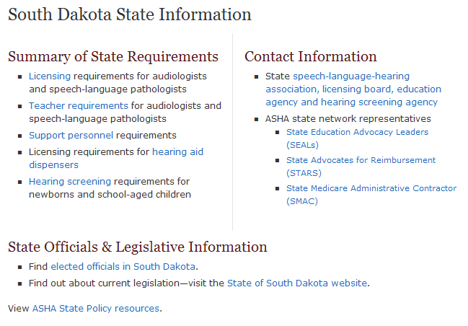

Slide 31
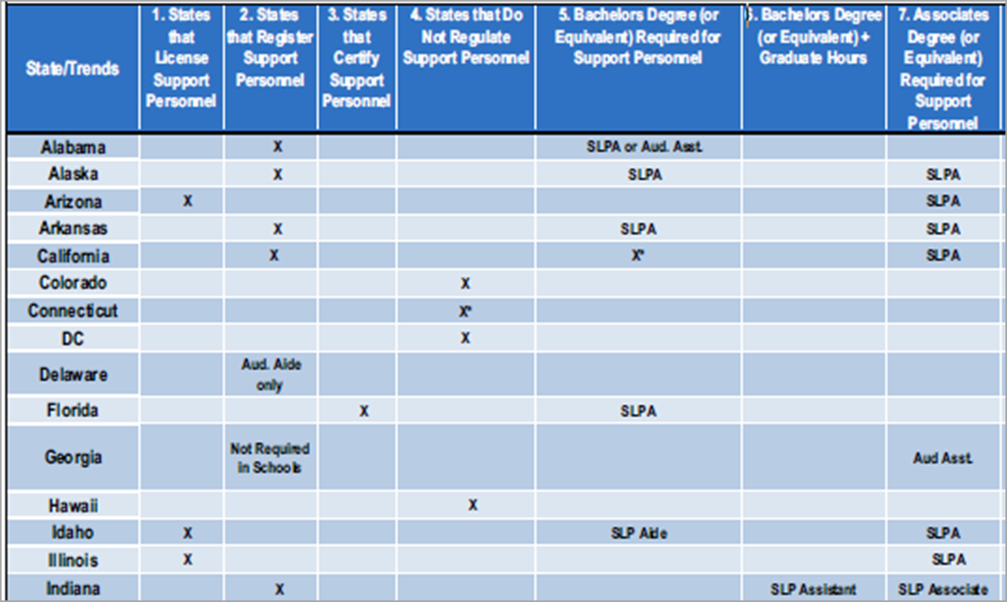
Support Personnel Trends
www.asha.org/uploadedFiles/SupportPersonnelTrends.pdf

Slide 32
Model Language for SLPAs and Audiology Assistants
Education
Supervision
Continuing Education
Title protection
http://www.asha.org/advocacy/state/state-policy/
Notes:
ASHA’s Board of Directors approved the development of model regulatory language for SLPAs and Audiology Assistants. This was one of the recommendations emerging from last year’s summit.
Audiology Assistants Requirements – High School Diploma or equivalent
SLPA Requirements - Associate’s degree or bachelor’s degree with an emphasis in speech-language pathology from an accredited educational institution plus a minimum of 100 clock hours of supervised clinical experience at the educational institution or during the first year of employment.
Continuing Ed. is using requirements that we use for the rest of the profession.
This information is now available in the state section of the web.

Slide 33
South Dakota SLPA Requirements
SLPAs are included in the statute
SLPAs must hold an AA or BA degree from an accredited institution
SLPAs must complete 100 hours of clinical training as a speech-language pathology assistant either during academic preparation or during their first employment
SLPAs must submit an official transcript verifying necessary academic preparation and clinical experiences
SLPAs must have not committed any act for which disciplinary action is justified
SLPAs must pay the fees established by the Board

Slide 34
South Dakota
An assistant shall be supervised by a licensed SLP who has at least three years of experience as an SLP
The supervising SLP
Is responsible for the extent, kind, and quality of service provided by the assistant, consistent with the board's designated standards and requirements;
Shall ensure that persons receiving services from an assistant receive prior written notification that services are to be provided, in whole or in part, by an SLPA;
May not supervise more than three SLPAs at one time

Slide 35
Other State Examples Texas Licensing Requirements
An applicant for an assistant in speech-language pathology must:
Possess a Bachelor’s degree in CSD from a university whose training program is accredited by ASHA or its agent
Have acquired 24 semester hours in SLP and/or audiology
Have earned at least 25 hours of clinical observation in SLP and 25 hours of clinical assisting experience in the are of SLP obtained within an educational institution or under the direct supervision at their place of employment
A licensed SLP shall assign duties and provide appropriate supervision to the assistant
A supervisory statement shall be completed by both the assistant and the supervisor who agrees to assume full responsibility for all services provided by the assistant
The licensed SLP supervisor will have practiced for at least three years and shall submit verification in writing

Slide 36
Texas Licensing Requirements
The licensed supervisor shall in writing
determine the skills and assigned tasks the assistant is able to perform
notify the client or family that an assistant will be providing the services
Develop the plan of treatment
Maintain responsibility for all services provided
The licensed SLP assistant shall:
perform duties within their scope of practice
The assistant may not:
represent the SLP or attend staff and IEP (ARD) meetings without permission of the SLP except under certain circumstances

Slide 37
Oklahoma SLPA Requirements
An SLPA must be licensed by the Board
An SLPA must hold an associate’s degree from an accredited institution
Continuing education requirements that apply for SLPs also apply for SLPAs
The board considers the following before granting a license:
Academic training and clinical experience
The specific duties and responsibilities assigned
The amount and nature of available supervision
The number of other persons assigned to the supervision

Slide 38
Oklahoma
The assistant must practice in a geographic setting which permits on site direct supervision
The SLPA license is granted for one year
A licensed SLP may not supervise more than two assistants at one time
Supervision and scope of duties follow ASHA guidelines

Slide 39
MI Requirements for Support Personnel
Support personnel are not regulated by the Department of Education or licensed by the state

Slide 40
ASHA Affiliates Program
“Associates” are speech-language pathology assistants who are eligible to join ASHA under a new affiliation program.

Slide 41
Why the Associates Program and Why Now?
Assistants are a fact of life.
ASHA is taking a leadership role to help resolve issues with the proper use of assistants.
Helping to ensure a continuum of care for clients and patients.
Notes:
ASHA completed a nationwide survey of SLP supervisors and practicing SLPAs and do you know what the two most important things that SLPAs wanted in an affiliation with ASHA?
Networking and the feeling of some place to belong

Slide 42
What are the Requirements for Joining as an Associate?
Potential applicants will be required to obtain the signature of their ASHA certified supervisors in order to become ASHA Associates.
If applicants are not employed, they will have to obtain the signature of their program director (or training program instructor) certifying that they are qualified to provide services under the direction of a CCC-SLP or CCC-A.
Applicants will have to agree to follow all ASHA policies related to responsibilities and supervision of support personnel.
Applicants will have to agree to practice only under the supervision of ASHA-Certified SLPs or Audiologists.
Applicants will have to pay annual fees to maintain their affiliation.
Applicants will also have to be qualified to practice in their state and follow the state licensure rules (if any) that are applicable to them

Slide 43
What Benefits Do We Have for Associates?
Networking opportunities with other assistants
Affinity benefits
Consultation provided by ASHA's professional practices staff
Listing and search capabilities on ASHA's online Member and Affiliate Directory
Opportunity to participate in advocacy efforts
Opportunity to participate in mentoring programs
Reduced registration fees for education programs and products
Online Career Center
Subscription to The ASHA Leader and access to The ASHA Leader Online (ALO)
Access to four online scholarly journals
Subscription to Associate e-newsletter
Associate e-Group (listserv/forum/social network)
Professional Development Hours (PDHs) for Associates

Slide 44
ASHA Associates
For more information about ASHA’s new associates program go to: www.asha.org/associates/default/

Slide 45
ASHA Resources
ASHA Guidelines on the Training, Use and Supervision of SLPAs: www.asha.org/docs/html/GL2004-00054.html
ASHA Associates Program: www.asha.org/associates/default/
ASHA SLP Professional Summit recommendations: www.asha.org/uploadedFiles/2011-SLP-Summit-Report.pdf#search=%22SLP%22
SLPA state trends: www.asha.org/uploadedFiles/SupportPersonnelTrends.pdf
SLPA requirements state-by-state: www.asha.org/advocacy/state/

Slide 46
SLPA Scenarios: SLP Perspective
Your administrator has asked you to supervise an additional full-time SLPA who will be in a facility on the other side of the state that you have limited access to. You already supervise three. What should you do?
Notes:
Actual calls for assistance regarding SLPAs
Let’s break into groups and discuss how to respond to these.
What questions would you have? what resources do you need?

Slide 47
Scenario #2-SLP Perspective
You are an SLP supervising an SLPA that you would like to utilize to assist with a hearing screening.
ASHA states that SLPAs can assist with speech-language and hearing screenings (without interpretation). Does this mean that the SLPA can help me conduct the screenings? Can the SLPA complete the screening and give it to me for interpretation?
Notes:
So long as the SLPA has been trained and demonstrates competency in administering the hearing screening tests, the assistant can administer them; not interpret them. You will also need to check with your State Health Department to see if they have any regulations related to who screens hearing in your state. If insurers are being billed for the screening, you will also need to see what they stipulate.

Slide 48
Scenario #3-SLPA Perspective
You’ve been an SLPA for 15 years in a local school. You’ve been responsible for planning, materials, data collection, input for goals & objectives according to student’s strengths and weaknesses, progress reports, attending annual meetings, etc.
How much supervision, (particularly direct) is required for you based on your experience?
Notes:
ASHA recognizes that assistants will have varying degrees of experience. The ASHA guidelines for use of assistants recognizes that there will be some variability depending on the skills of the assistant.
ASHA indicates that, “The amount and type of supervision required should be based on the skills and experience of the speech-language pathology assistant, the needs of patients/clients served, the service setting, the tasks assigned, and other factors.” The minimum amount of supervision ASHA recommends is 20% supervision weekly, with no less than 10% weekly being direct supervision. (For a 40-hour workweek, this is 8 hours of supervision, at least 4 of them direct supervision.) The 20% direct supervision is only stipulated for the first 90-day work period. The ASHA members who wrote the guidelines considered many factors in deciding on the amount of supervision to recommend (e.g., state licensure laws, clinical experience, previous guidelines) and consider 10% direct and 10% indirect to be the most reasonable and minimum amount of supervision.

Slide 49
Questions:
Contact: Janet Deppe, State liaison for Michigan at jdeppe@asha.org or by phone at 301-296-5668
ASHA Associates Program: associates@asha.org

