Slide 1
Beyond the Plateau:
Unlocking Progress via Oral Mechanism Exams and Myofunctional Strategies Across the Lifespan
Michigan Speech-Language-Hearing Association
2026 Conference
Michelle Richards, CCC-SLP, TSLI, CLC
Notes:
Thank you for opportunity to present, attending

Slide 2
Disclosures
Financial: I am the owner and Clinical Director of Oakland Myo and Wellness Institute and receive a salary for therapy services and programs.
Non-Financial: I have been a school-based Speech-Language Pathologist for 23 years and continue to serve part-time in a public school setting. The views expressed in this presentation are my own and do not necessarily reflect the policies or positions of my employer.
2
Notes:
Disclosures

Slide 3

Learning Objectives
1. Analyze the physiological impact of oral-motor restrictions across clinical settings
2. Correlate tongue tension and myofunctional deficits with specific speech and fluency disorders
3. Formulate effective interdisciplinary referral pathways
3

Slide 4
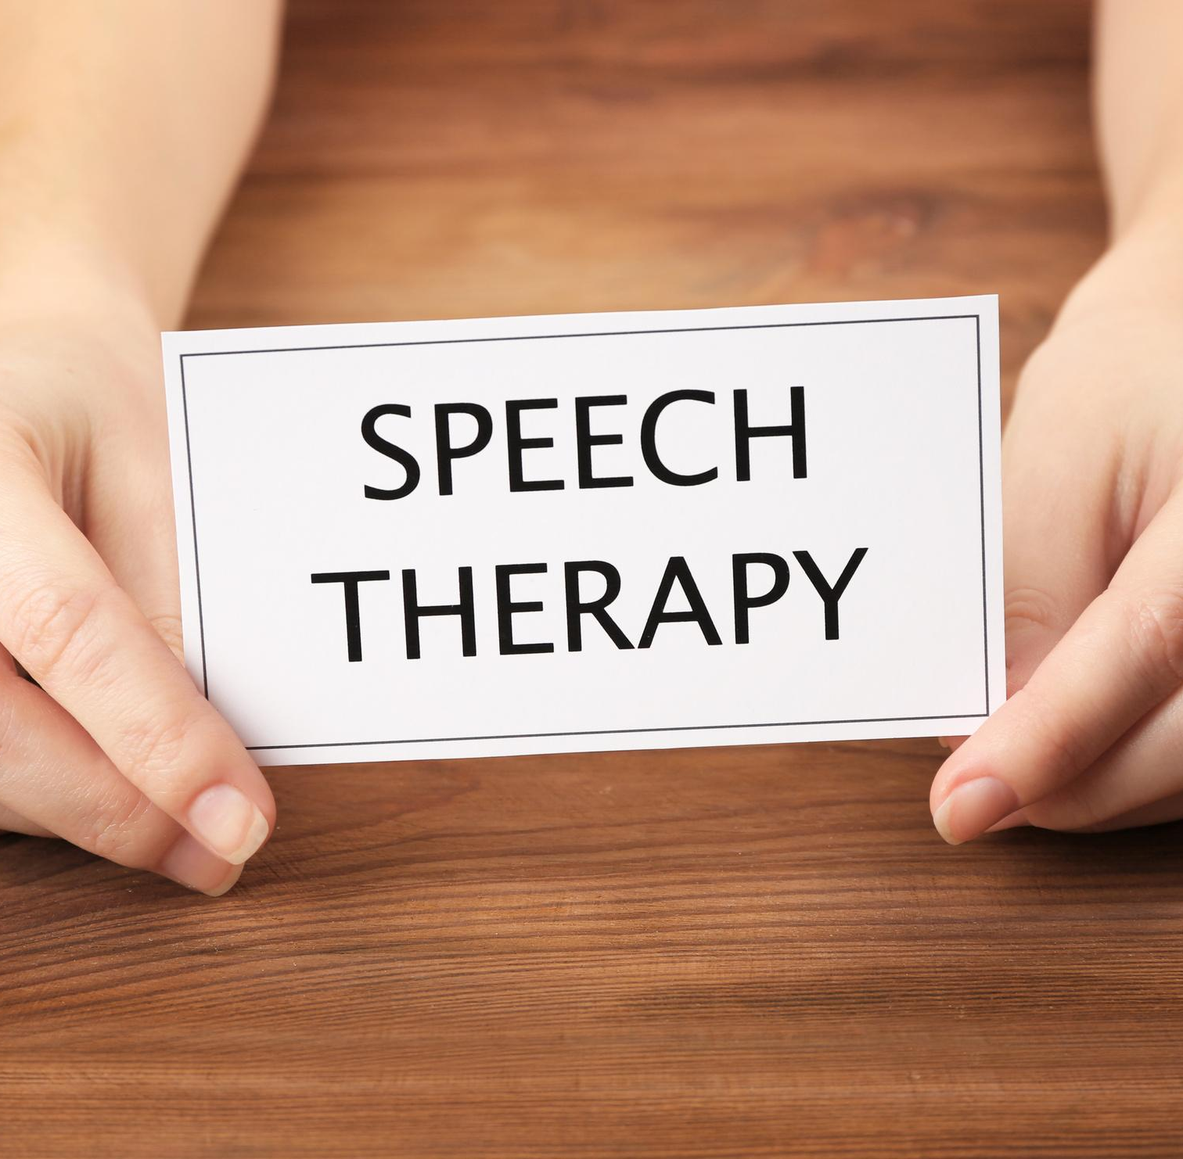
We are healthcare providers
Regardless of the setting, we support "patients".
We all entered this field with a desire to help others and an interest in education and health.
4
Notes:
As we all are at the root, a healthcare provider, despite the setting we serve, I will use “patient” throughout this presentation to refer to the client or student we are supporting.
Though we all have our personal story, I think it's fair to say we all got into the field with a desire to help others, as well as an interest in education and/or healthcare - which certainly helped a friend or family member along the way.
I think we can also appreciate the similarities we generally have as a profession: we give a lot of ourselves, we love to excel, and it’s really hard to admit when we’re struggling to make progress with a patient. And as humans, we don’t like our boat to be rocked; it can be very uncomfortable to have our thinking and way of doing things challenged. I applaud you for attending this MSHA conference to become a better clinician, to be open to learning new ideas, and specific to this presentation: looking at really uncomfortable data or at a patient’s case a bit differently. My wish today is for you to offer yourself some grace and forgiveness for what you didn’t know

Slide 5
The plateau that’s felt by the clinician, patient, and caregiver
Shame: “I am bad”
Blame: a defense
5
Notes:
Along the way, we’ve had some memorable patients: some that gave us pure joy, and others that gave us such challenges, we likely doubted ourselves, our extensive training, our methods, and our proficiency. And when we revisit our notes, consult a colleague, or order new materials, we often feel reassured that we have done everything we could do - and we’re drawn to blame the client. They must not care, they must not be practicing, they have lost motivation, they don’t have the family support, there are bigger issues in the family that overshadow the ability to do what we’re saying, etc, etc.
Let's consider for a second the patient's side. Self-consciousness develops around 2-3 years old - it’s simply being aware of themselves being separate from others, and is developing around the same time toilet training and the understanding of rules develop. When children realize they have violated a social standard or parental expectation, they feel shame. Guilt is “I did something bad”, whereas shame is focusing on the self, “I am bad.” An instinct to blame starts in early childhood as a defense mechanism. The perceived threat is often adult disapproval or punishment), they may instinctively shift focus towards another person (“they made me do it!”) to preserve their safety and connection to others.
If a patient is not achieving the skill we’re asking them to do -one more time… ok, one more time- it’s only natural for them to feel shame, or blame us for their lack of progress as their expert.
For simplicity sake, let’s consider a child who has multiple speech sound errors. Even when I have presented to newer graduates, they are still receiving much of the same message I did: we can do an oral mechanism evaluation and note the narrow palate or overjet, but exactly how it impacts speech sound production in spontaneous speech or why the patient is a messy eater or why they mumble is quite hazy. Maybe another patient can ace a GFTA - so it’s not our problem, it’s ‘just how they are’ and ‘they just need to enunciate more’, right? It’s starting to sound a little like shaming the patient now, isn’t it? "This cycle of blame is exhausting and unproductive.But what if the problem isn't the patient's effort, but an issue we haven't been trained to see?"

Slide 6

Look at your uncomfortable data
6
Notes:
But what if we could help? And we had a sprinkling of more expertise to answer these questions?
My proposal today is to roll back the clock to the beginnings of our field and explore the fundamental knowledge at that time, then add in some modern technological enhancements with collaboration across related professions. That’s what I think being a SLP in 2026 is all about-

Slide 7
100 year old “modern” idea
1907: Dr. Edward Angle, an orthodontist, identified:
  The tongue is an “obstacle”
  Nose breathing impacts tongue posture and malocclusion
2019: Linda D’Onofrio, an SLP, publishes “Oral Dysfunction as a Cause of Malocclusion”
  Echos Angle’s statements
  Includes a plethora of additional research since his claim!
7
Notes:
In 1907, Edward Angle (an orthodontist and owner of several orthodontic schools around the nation) published Malocclusion of the Teeth, which had very novel, modern thinking we have much greater research supporting supporting today:
The tongue can be ‘an obstacle’ in orthodontic treatment
Nasal breathing caused low tongue resting posture and certain malocclusions
In 2019, fellow SLP, Linda D’Onofrio published “oral dysfunction as a cause of malocclusion” in the Orthodontics and Craniofacial Research journal where she echoed Angle’s statements and noted the impacts of breastfeeding, airway obstructions, soft tissue restrictions (such as lip, tongue or buccal ties), oral rest posture (of the jaw, lips, and tongue), oral habits (such as thumb/finger sucking, chewing on items), swallowing, chewing, mouth breathing, and how it can impact develop as young as a prenatal infant.
D’Onofrio runs the Oromyofunctional Study Group on Facebook. She states the tongue is the natural expander, and lips are the face’s braces. If the tongue is resting up, within the palate in a light suction, as the tongue grows, it should naturally expand the palate. And as the space between the teeth increases, the roof of the mouth drops -this further supports the tongue’s ability to create a suction on the palate for a healthy, efficient swallow.

Slide 8
Myofunctional Timeline for SLPs
1918: Rogers orofacial muscles are “living appliances”
1948: Lischer coins “myofunctional”
8
Notes:
In 1918: Alfred R. Rogers, an orthodontist, suggested exercises to develop tone and muscle function in the orofacial area to balance the muscles that were causing malocclusion. He suggested the idea that the orofacial muscles could act as “living orthodontic appliances”. So it was orthodontists originally creating these exercises; then they recruited speech therapists to use these exercises to support the swallow and oral resting posture.
This therapy practice continued, but it was in 1948 (30 years later!) the term “myofunctional therapy” was used by Benno Lischer.

Slide 9
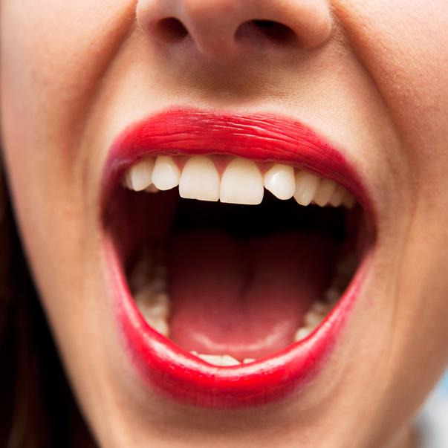
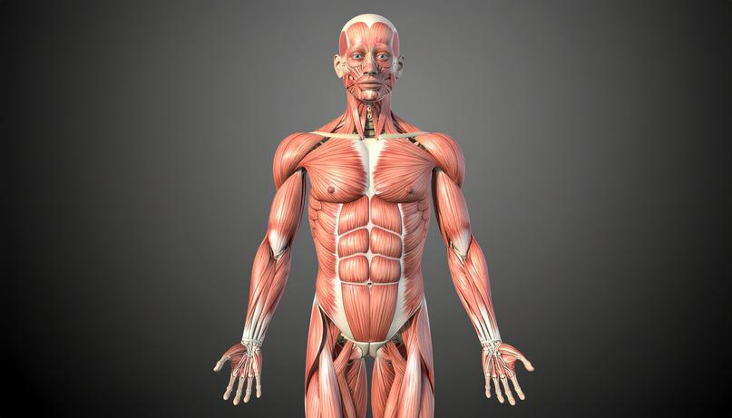

The “Myo” Confusion
Orofacial = Oral + Face
Myo = Muscle
Function!
9
Notes:
I find it to be very confusing to many people. “Is it a new therapy? I’ve never heard of it before.” It’s confused with myofascial. It’s not the easiest to say, and it’s confusing to anyone who first hears it without it being broken down. The term ‘myo’ comes from Latin meaning “muscle” as in “myopathy or myocardium”. With ‘functional’ added to it is simply “muscle function therapy”. But good golly, if you add “orofacial” to “myofunctional”! It’s enough for many of us to feel intimidated, want to step back, perhaps have flashbacks to Anatomy & Physiology, and wonder how much you really remember of it anymore - or do you want to?

Slide 10
Myofunctional Timeline for SLPs
1918: Rogers orofacial muscles are “living appliances”
1948: Lischer coins “myofunctional”
1972: Myofunctional organization formed
1991: ASHA adds OMDs to
Scope of Practice; 2016: explicitly in “Speech Production” and “Feeding & Swallowing” domains
2018: ASHA adds OMDs to Practice Portal
2020: ASHA adds to CAA Graduate Standards
10
Notes:
From the late 1950’s to early 1970’s, chatter continued about creating a group for these “tongue thrust” specialists. An organization was ultimately formed in 1972. The value of myofunctional therapy was briefly considered by ASHA in 1974, but they wanted further research.
ASHA (the American Speech-Language-Hearing Association) officially recognized Orofacial Myofunctional Disorders (OMDs) as being within the scope of practice for speech-language pathologists (SLPs) in the early 1990s, following decades of professional debate and collaboration with orthodontic associations.
Key policy milestones of Including Orofacial Myology into ASHA:
1989: ASHA established an Ad Hoc Committee on Labial-Lingual Posturing Function to investigate the SLP's role in treating "tongue thrust" and related issues.
1991: A pivotal Joint Position Statement was released by ASHA and the American Association of Orthodontists (AAO). This document officially recognized that OMDs are within the scope of practice for SLPs and that treatment (OMT) is effective for certain dental and speech issues.
1993: ASHA published the Knowledge and Skills document specifically for Orofacial Myofunctional Disorders. This provided the clinical framework for how SLPs should evaluate and treat these conditions.
2016: The Scope of Practice in Speech-Language Pathology explicitly lists "Orofacial Myofunctional Disorders" under the "Speech Production" and "Feeding and Swallowing" domains.
2018: ASHA launched the OMD Practice Portal for evidence-based guidance and clinical resources - though I’ll note, from talking to a couple of the authors, a significant number of pages of references were removed, and there was a preference for ASHA journal citations.
2020: ASHA officially includes Orofacial Myofunctional Disorders (OMDs) in CAA/Graduate Programs
Before 2020, exposure to myofunctional therapy in grad schools was optional or very dependent on the university’s curriculum. Now, all clinicians can have a foundation in OMDs to support and guide their clinical practice, regarding the setting.
Orofacial myology is now a required component of graduate education in order for a program to maintain its CAA (Council on Academic Accreditation) status. Because CAA programs must prepare students to meet ASHA’s Certification Standards (CCC-SLP), they are bound by the following:
1. The 2020 Certification Standards
Under Standard IV-C, graduate students must demonstrate knowledge of communication and swallowing disorders across nine specific areas (the "Big 9"). Orofacial myology is explicitly named under:
Standard IV-C, Area 5: "Swallowing/feeding, including (a) structure and function of orofacial myology and (b) oral, pharyngeal, laryngeal, pulmonary, esophageal, gastrointestinal, and related functions across the life span."

Slide 11


Patient does not have a cleft palate!
11
Notes:
So what if you didn’t graduate to benefit from the 2020 Certification Standards? Or if you had it, what did it look like from your university? Ideally, there’s a full course on orofacial myology. At a minimum, the orofacial anatomy and physiology is taught in both swallowing and speech sound coursework. Let’s relook at an oral mech exam - but add in function. And, hey, if you learn more, there are countless opportunities from fellow SLPs and other professions, primarily dental conferences focusing on airway health.
As I’ve presented and engaged with other clinicians, it seems we’ve all had similar experiences. We’ve all had a classic Oral Speech Mechanism Screening tool in our clinics. We get intimidated at dental occlusions -and well, perhaps a lot of the boxes when we need to make a clinical determination about what is normal or abnormal. But we all seem overwhelmingly reassured when we can confidently mark “does not have a cleft!”

Slide 12
  1
  2
  3
SLP: “Something isn’t right”
Refer to ENT
ENT: “They’re fine! They need therapy!”
12
Notes:
If you were confident enough to check all of the boxes, you would then receive a Pass or Fail. The Fail would indicate you needed to refer -typically to an ENT- and they would never find a deficit. Frustrating to you and the patient! I don’t know that I’ve met a clinician that could clearly complete the Oral Mech screening AND be able to confidently explain each box they checked, so it became a tool to offer several comments you could include in your report. Ultimately, thinking, ‘well, that’s a mouth that looks like it should be able to talk!”, and we quickly move to the parts of the evaluation we feel more confident in.

Slide 13
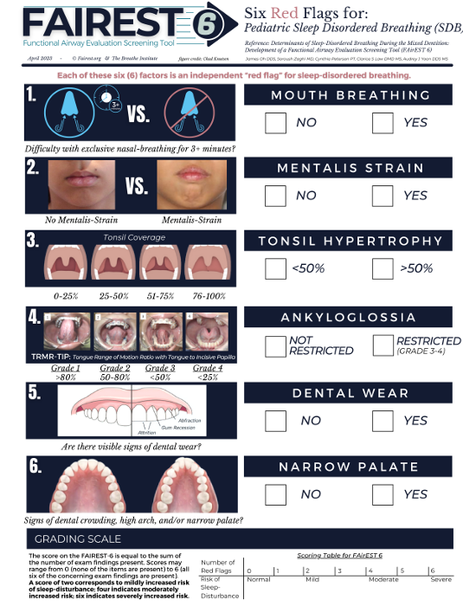
The FAirEST 6
  Created by a multidisciplinary team
  Outlines “red flags” for Sleep Disordered Breathing (SDB)
  Provides objective score
  Guides referral to medical or dental provider
  Looks at the root cause
13
Notes:
For a tool you can access today, for free, I’ll propose using the FAIREST-6 for pediatric populations, or the FAIREST-6+4 for adult populations. The Adult version is a bit more enhanced given growing is complete; further assessment can be completed on the tissue’s flexibility and availability of space within the dentition and palate. It’s quick and easy to administer, and my hope today is to enhance your smarts to understand what function we’re looking for in an exam to enhance your rate of treatment as a clinician, collaborate with related professionals, and get to the root cause of a patient’s needs.

Slide 14
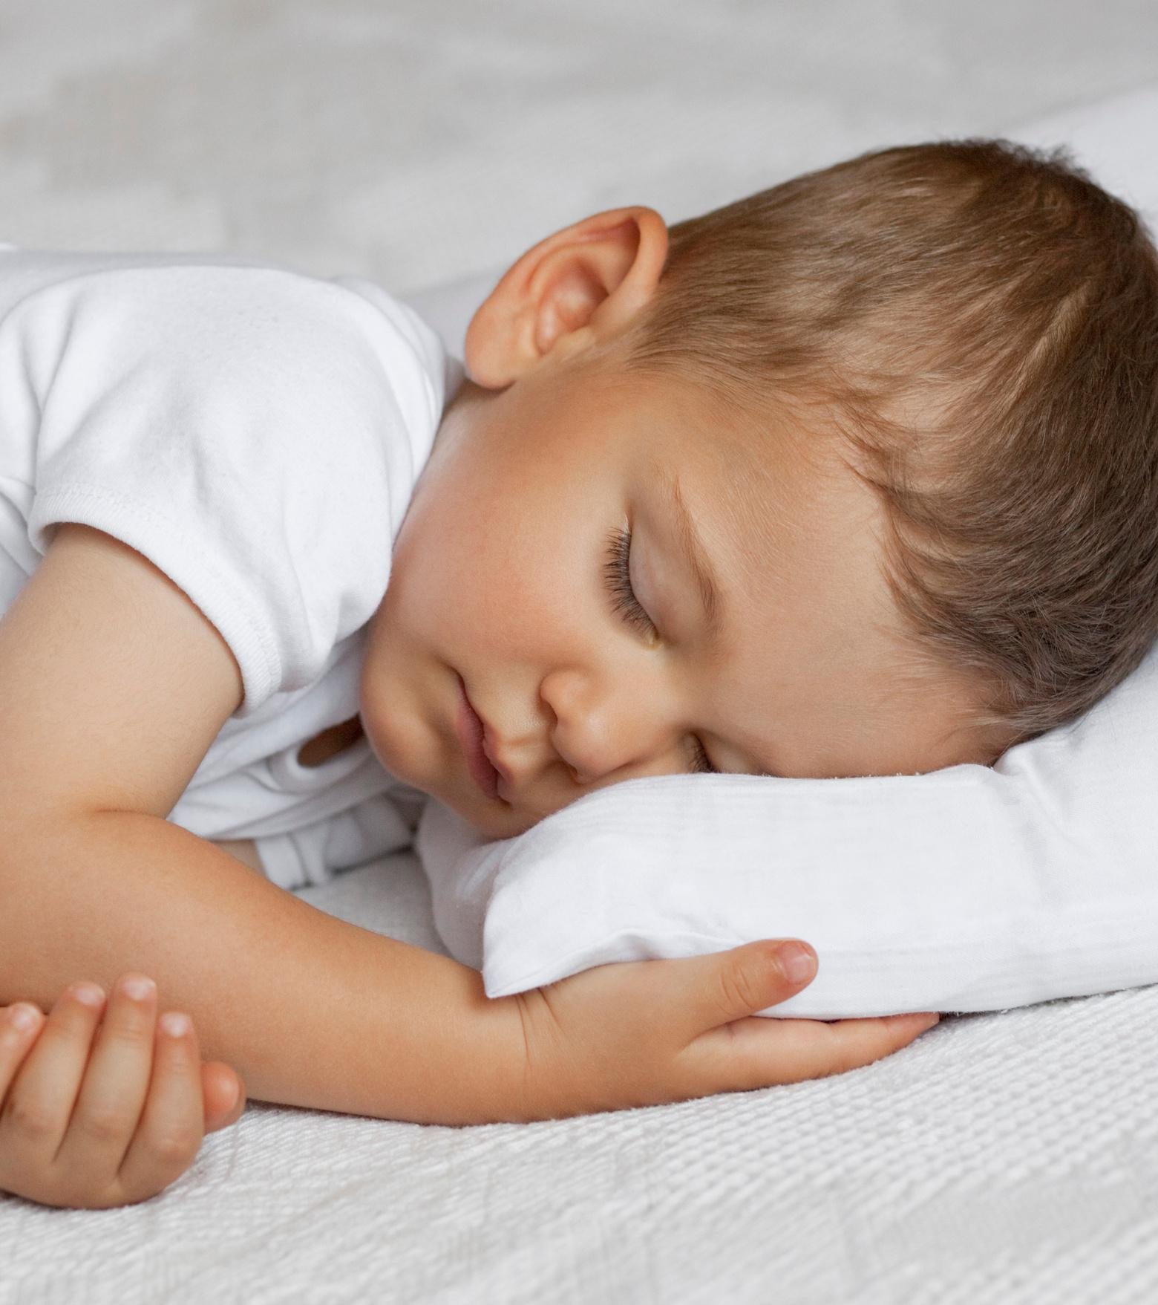
S is for Sleep*
*A biological need, not a luxury
14
Notes:
You might notice it is a tool for evaluating sleep-disordered breathing (SDB). We know the quality and quantity of sleep is important - but the amount of research is overflowing, and is very complimentary to the work we do as SLPs.
Transfer short-term information into long-term memory
Executive functioning
Problem solving
Clear waste, restore the body
Boost immune system
Regulate sympathetic nervous system
Reduces blood pressure (helpful for significantly reducing long-term risk of hypertension, stroke, and heart disease)
Reduce stress, anxiety, and emotional lability
I have a whole separate presentation about the impacts on learning -

Slide 15

The ADHD
Red Herring
AAP and AASM guidelines state clinicians MUST refer for a sleep study if snoring or daytime sleepiness is present before concluding an ADHD diagnosis
15
Notes:
So, the science of sleep is clearly relevant to our patients. Now, let’s take this information and blend it with a diagnosis we all know well: ADHD.
Official guidelines from the American Academy of Pediatrics (AAP) Clinical Practice Guidelines for ADHD state an evaluation must include assessment for co-exiting or alternative conditions, specifically highlighting sleep disorders (such as Obstructive Sleep Apnea (OSA), Restless Leg Syndrome). If there is loud snoring, restless sleep, paused breathing in sleep, or excessive daytime sleepiness, the clinician is directed to refer the patient for a sleep study before concluding ADHD is the correct diagnosis.
The American Academy of Sleep Medicine (AASM) Guidelines not neurobehavior complications -specifically hyperactivity, inattention, and poor school performance- are hallmark daytime symptoms of pediatric OSA, and patients with these symptoms should be routinely screened for snoring and sleep-disordered-breathing (SBD).
I think you’ll see the connections to our patients now, and perhaps the FAIREST 6 is a little less intimidating to use than a traditional Oral Mech screening. You may also note we’re looking at the function of what the tongue is doing - this is essential for how we breathe, speak, chew, swallow, and sleep!

Slide 16

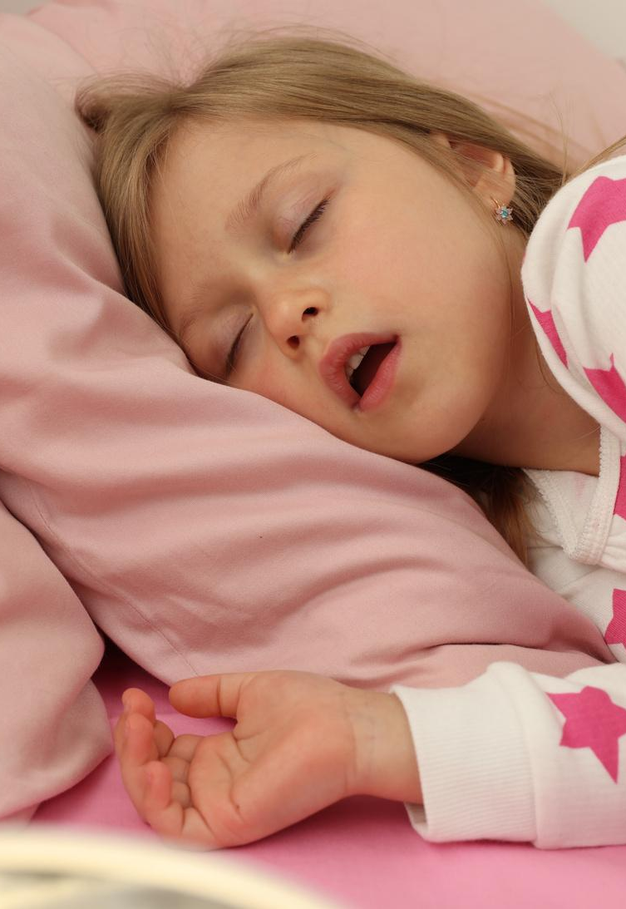
#1
Nose vs Mouth Breathing
16
Notes:
Number one on the FAIREST 6 is whether or not the patient is a nasal breather during the day - but also during the night. Nasal breathing should occur 24 hours/day.
Mouth Breathing is Impacted by:
Allergies & sinus problems
Food sensitivities
Respiratory infections
Enlarged tonsils & adenoids
Asthma
Deviated septum
Nasal polyps
Low tongue posture
Oral habits (pacifiers, thumb/finger sucking

Slide 17
Your Breathing Options
MOUTH BREATHING
NOSE BREATHING
Smaller airway
Sleep disordered breathing
  snoring, UARS, apnea, daytime sleepiness
Suboptimal facial structure growth + esthetics
Reduce mental and physical health
Behavior problems
  inattention, hyperactivity
Reduced cognitive functioning
Healthy orofacial muscle development
Optimal head + face development
Filtering, warming, & humidifying air before it enters our body
Increase circulation throughout our body
Reduce anxiety
17
Notes:
Breathing from our nose vs mouth will have significnat impacts in 3 areas of science within our body: the psychology, the mechanics, and the chemistry. As we slow our breathing rate, the autonomic nervous system relaxes. We might notice more saliva in our mouths or warming of our fingers and toes.
The body might want to yawn as the chemistry adjusts - suddenly wondering why we're not huffing and puffing from our mouth so quickly, and taking a fast breath in to adjust the chemistry. We start to hold carbon dixoide in a bit longer, slowing our breath rate - but this is a good thing! Too much air too fast causes light headedness .
Longer, slower breaths can suddenly become deeper -into our diaphragm, further slowing our breathing (causing the chemoreceptors, the chemical receptors to not be so bothered by holding in the carbon dioxide in a smidgen longer - further calming the brain. <ping pong SSW kiddo>
And as our breath moves into the diaphragm, the mechanics of the ribs and the diaphragm begin -expanding and contracting, working the intercostal muscles. With improved breathing, circulation improves; "dump trucks from the extremities" work more efficiently to bring oxygen to the muscles, despite breathing less - which is why you'll see athletes wearing breathing strips or nasal dialators! I would too for a $5M contract!

Slide 18
#2: Lip Closure, Mentalis Strain
18
Notes:
#2 on the FAIREST 6 looks at the mentalis muscle as the lips close. When we assess a patient, we look at how easily the lips close? Can you see facial muscles overactivating to obtain lip closure, perhaps as they press together, or perhaps as the mentalis muscle presses the lower lip up to meet the upper lip? Is the dentition (usually an overbite, Class II occlusion) limiting how easily the lips can close? Or does the upper lip seem like it’s shorter and unable to reach the lower lip with ease? With weakness, we may see a lower lip droop or an upper lip look thinner. If there is chronic mouth breathing, the upper lip ‘doesn’t receive the message’ to grow to remain in contact with the lower lip, causing to to appear shorter, and in severe cases, quite inactive during speech.

Slide 19
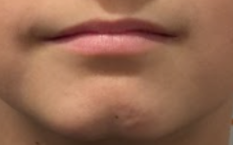
19

Slide 20
Breathing & Oral Rest Posture Referrals
  Lips naturally close at rest / are able to close without facial strain, chin wrinkling
    If not, refer to a clinician specializing in orofacial myology
  Resting position of tongue is up, behind front teeth
    If not, support in therapy
  Nasal breathing can be sustained for at least 3 consecutive minutes
    If not, refer to physician / ENT for upper airway assessment
  Breathing is quiet
    If not, refer to physician / ENT for upper airway assessment
    Can support slow, diaphragmatic breathing in therapy
20

Slide 21
#3 Hard & Soft Palates, Pharynx
21
Notes:
We move to #3, evaluating the tonsils to determine if they’re covering more than 50% of the airway. This alone is a reason to have concern for Sleep Disordered Breathing, however without clear documentation or understanding from the parent, medical providers generally dismiss these concerns. Ethically, we are responsible to report Grade 3 and 4 tonsils given their airway obstruction and likely contribution to a low-, forward-resting tongue in order to breathe.
Additional observations of the soft palate may be observed, such as if it appears elongated, toned or weak, symmetrical, and how active the uvula is in elevating it.

Slide 22
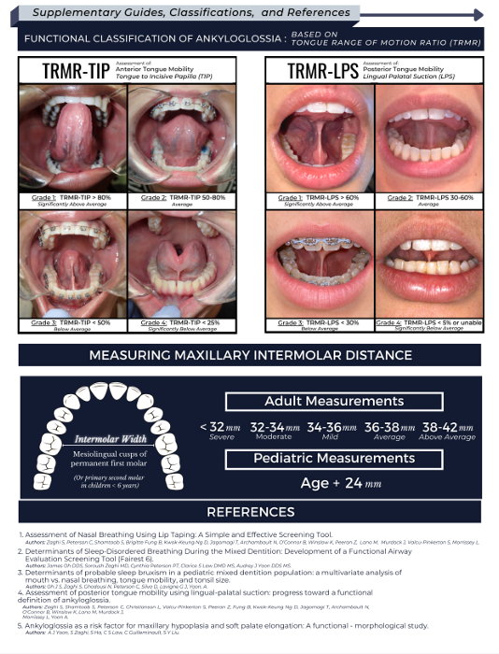
#4 Tongue Range of Motion: TIP
Maximum Opening (comfortably):__________
Tongue to the Incisive Papilla (TIP) : __________
TIP / Maximum Opening: __________
by measurement
(we still need to look at FUNCTION)
Grade 1, 2: normal functioning
Grade 3 = 25-49%, “moderate restriction”
Grade 4 = <25%, “severe restriction”
22
Notes:
#4, Tongue Range of Motion: we’re looking at how easily the tongue can move about the mouth. To do so, you start with the mouth opened wide; then elevate the tongue tip to aim right behind the front teeth. If your tongue tip can elevate more than 50% to behind your front teeth, this is considered to be adequate. If not, it will rate as being restricted, or a “tongue tie.” The tongue simply lacks mobility to move about the mouth. It is a critical measurement or observation; when we see a restricted tongue, we start to see the jaw jut forward as a compensation (wearing on the TM joint), muscle tension dysphonia, tongue thrusting, and speech sound distortions (lateral lisps, anterior lisps, distortions, lack of stabilization on the molars causing jaw jutting, etc)
I’d also add on to evaluate if the tongue can sweep the molars to remove any food after eating. The inability to do so simply causes food to remain in contact with the teeth, promoting cavities. Even if there is not a speech-related issue, this is essential for oral hygiene.
There are additional measurements and compensations we can assess, but we’ll save that for a full, formal myofunctional training course.
In my experience, as we treat the tongue’s strength and coordination <the motor system>, the sensory system begins to integrate as well and we start to see a significant improvement in the ability to try foods that were previously avoided - 8 foods @ thanksgiving for 8 yr old with some feeding therapy strategies

Slide 23
#4 Tongue Range of Motion: LPS
Maximum Opening (comfortably):__________
Lingual Palatal Suction (LPS) : __________
LPS / Maximum Opening: __________
by measurement
(we still need to look at FUNCTION)
Grade 1, 2: 30 - >60% normal functioning
Grade 3 = <30%, “moderate restriction”
Grade 4 = <5%, “severe restriction”
23
Notes:
An expansion on the tongue’s range of motion is the ability to open with the tongue in full lingual palatal suction, LPS. It’s essential for a healthy swallow to get propulsion. A fully sealed tongue will eliminate any air from being swallowed, preventing excessive burping, gassiness, or discomfort in the stomach.

Slide 24
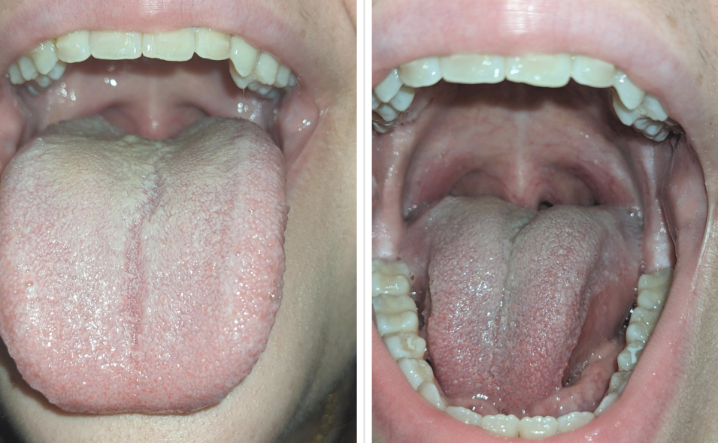
24

Slide 25
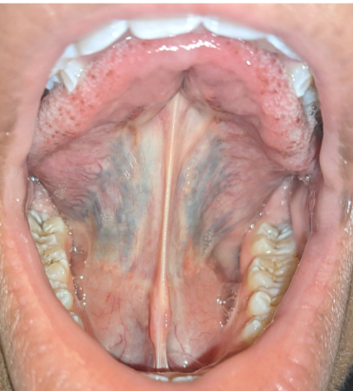
25

Slide 26
Lingual Functioning Referrals
  Tongue Range of Motion Ratio Grade 1-2, tip is >50% elevated towards incisive papilla when mouth is fully opened
    If not, refer to clinician specializing in orofacial myology
  Lingual Palatal Suction (LPS) shows adequate space for the tongue to fit within it; tongue does not overflow over the middle of the teeth bilaterally
    If not, refer to dentist for growth check (2-4 years old) or evaluate for orthodontic expansion to allow lingual palatal suction
  Tongue can sweep molars
    Can support oral motor skills in therapy
    If not, refer to clinician specializing in orofacial myology
26

Slide 27
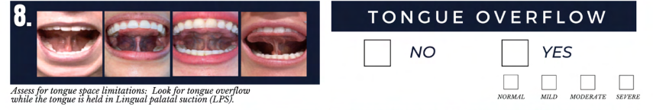
#5, 6, 8: Dentition
27
Notes:
#5, 6 & 8: Can you see wear on the teeth from clenching or grinding? There’s a central nervous system reflex that pushes the lower jaw forward to open the airway if there’s constriction.
Does the palate have a U-shape, or more of a V-shape? Does the palate shape offer enough width, and is it low enough for the tongue to be able to fit in it if the patient creates a lingual palatal suction? If the tongue is resting in the palate, as it grows, it should be naturally expanding the maxilla. And as it does so, the roof of the mouth moves down, closer to the tongue, making it easier and more functional to swallow and rest in a healthy position - in addition to having dental structures positioned for good speech sounds and a good swallow. We should be using a lingual palatal suction with at least the tongue tip when at rest (and in our sleep!), and a full suction when using a healthy swallow.
How much overflow does the tongue have onto the occlusal (chewing) surface of the teeth? If it’s more than half, it’s a concern - there’s just simply not enough room for the tongue to fit within the palate. And again, based on a healthy swallow, but also how we are creating speech sounds with molar stabilization, we need our tongue to fit within our palate with ease - we don’t have time to wedge it in during typical, rapid conversational speech. Further, if there is just too much tongue and a narrow space, it creates infringement into the airway as the tongue cannot rest within the palate, causing it to drop back into the airway, especially in a supine position.
I’ll leave numbers 7, 9, and 10 for self-exploration, if desired as it starts to move a bit away from what I’m looking to focus on today.
A myofunctional assessment will continue with looking at the ability to move and coordinate the lips, tongue, and jaw with independence. And similar to PROMPT, it moves in a very similar order for assessing and treating as we need a solid foundation to build from.

Slide 28
Intraoral Structure Referrals
  Palate is U-shaped, is <7mm high, no signs of crowding
    If not, refer to dentist for growth check (2-4 years old) or evaluate for orthodontic expansion to allow lingual palatal suction
  Tonsils: Brodsky Grade 1-2, >50% oropharynx
    If not, refer to Physician/ENT: airway obstruction impacts tongue placement at rest / in speech, swallow
  Teeth do not show dental wear / no observed or reported clenching, grinding
    If not, refer to Physician/Dentist: sign of airway compensation
  Friedman: Class I-II
    If not, monitor as therapy progresses; can note to Physician/Dentist
28

Slide 29
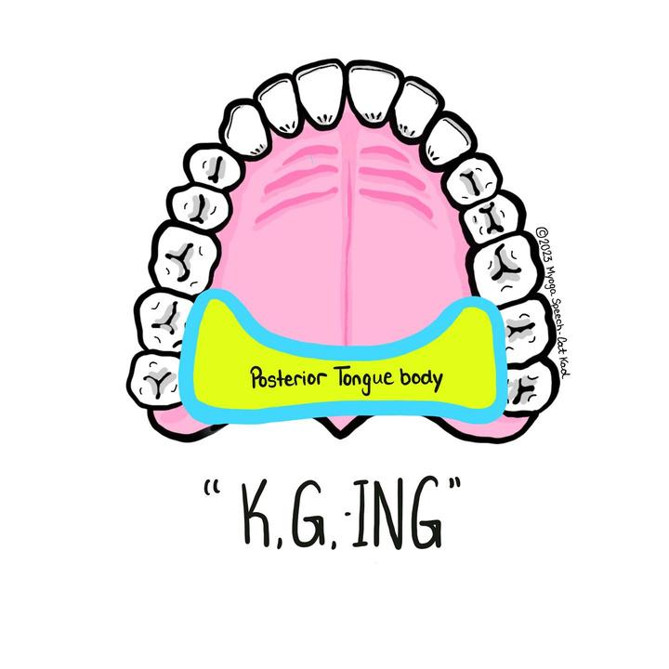
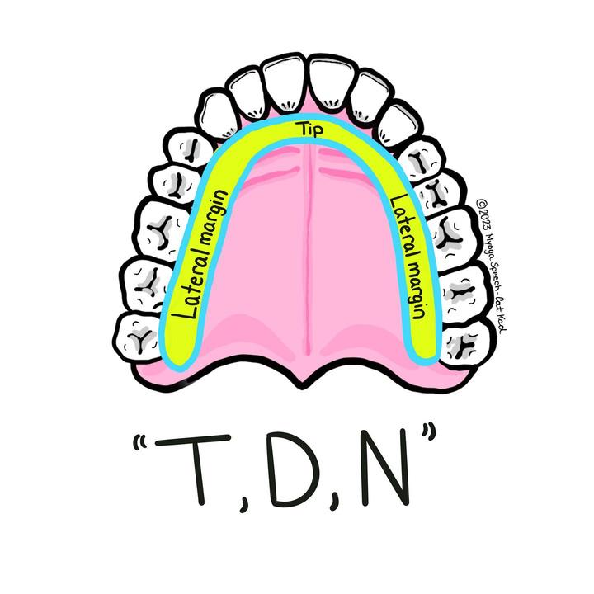
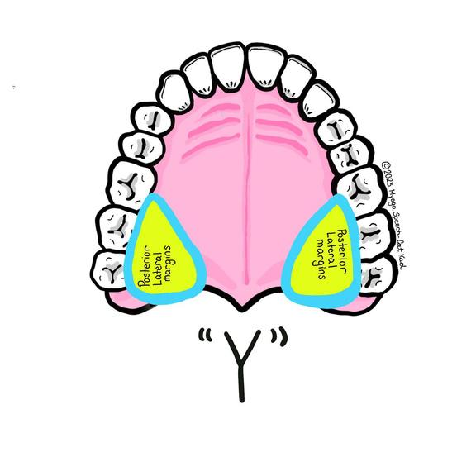
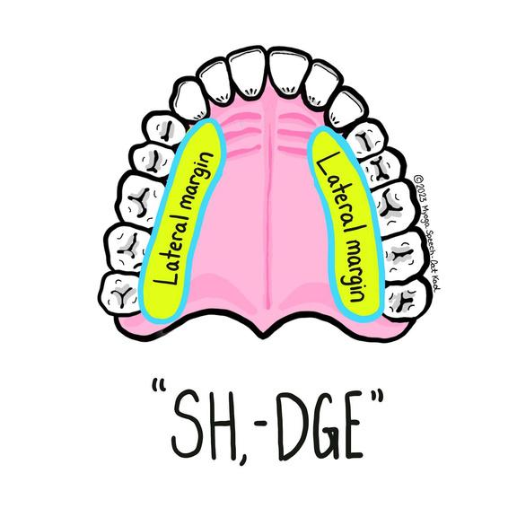
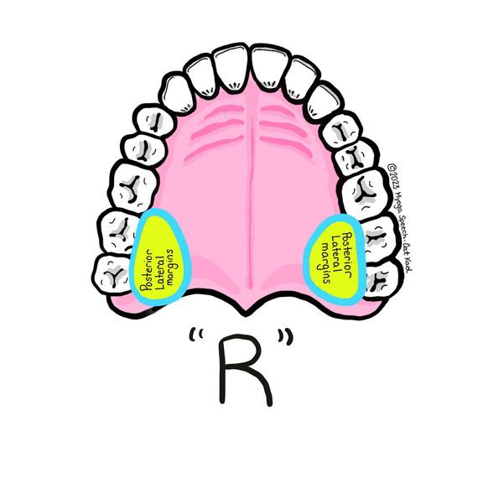
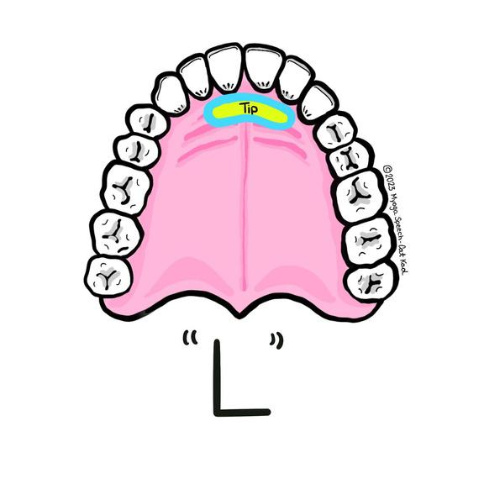
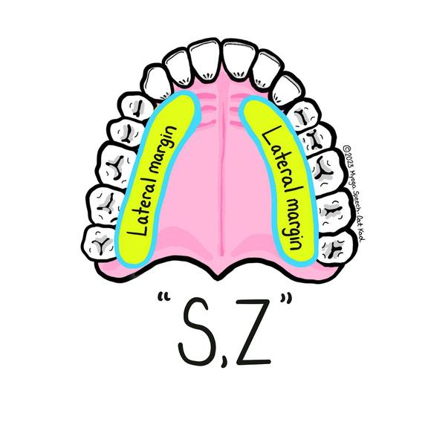
Articulation Stabilization
29
From Pamella Marshalla
Notes:
Pamella Marshalla wrote extensively about oral functions, including obtaining molar stabilization for speech sounds. The yellow spots on these illustrations are where the tongue should be anchored for articulation. Without bracing or grounding, the tongue grasps to find its place - this is when we may see frontal or lateral lisps, tongue thrusts, and distorted /r/ sounds.

Slide 30
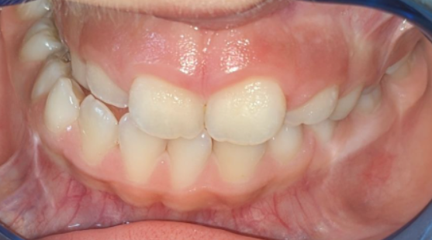
30

Slide 31
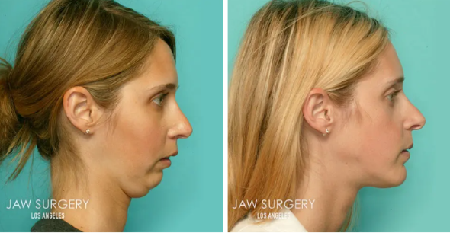

Slide 32
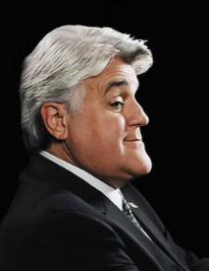
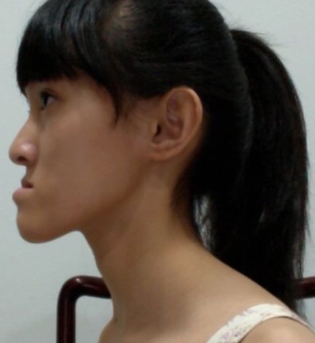

Slide 33
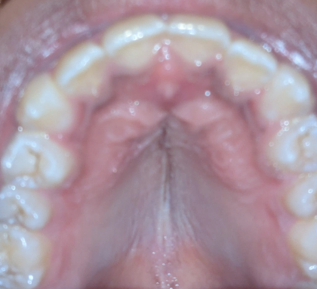
31

Slide 34
1
Why did some produce /s, z/ with lower incisors?
Why were my students the most disruptive in their classrooms and often known throughout the school?
Why were so many of my students referred for evaluations for Learning Disabilities?
Why were 5/6 of the slowest running students in Gym class my students?
Why did I hear so many a/ae substitutions in my most impaired articulation kids?
  2
My Speech Room Wonders
  3
  4
  5
32
Notes:
Despite all of my training, I ran into puzzles that just didn’t make sense:
Why did some of my students use their lower incisors for /s, z/ productions?
Why were my students at the school the most disruptive in their classrooms, and often known throughout the school?
Why were so many of my students referred for Special Education evaluations to consider learning disabilities?
Why were 5/6 of the slowest running students in gym class my Speech students?
Why did I hear so many a/ae substitutions in my most impaired articulation kids?

Slide 35
1
Why did some produce /s, z/ with lower incisors?
Why were my students the most disruptive in their classrooms and often known throughout the school?
Why were so many of my students referred for evaluations for Learning Disabilities?
Why were 5/6 of the slowest running students in Gym class my students?
Why did I hear so many a/ae substitutions in my most impaired articulation kids?
My Speech Room Wonders
  2
Solved!
  3
  4
  5
33
Notes:
Myofunctional evaluations and therapy were able to answer all of these questions:
If we consider the place, manner, and voicing of speech sounds “rules”, deviations from where a speech sound is made, such as using the lower central incisors, rather than the uppers, is a compensation in placement. A previous compensation I mentioned was using a jaw jut: this is moving the jaw forward so the tongue tip can typically reach the alveolar sounds.
Sleep research supports my behavior and learning concerns.
Dysfunctional breathing (often mouth breathing) contributed to poor efficiency when they ran
Another wonder I have is about the number of kids diagnosed with apraxia. Without jaw stability, or the ability for the lips to move independently of the jaw, and/or the tongue having a restriction OR lacking molar stabilization, it will certainly look like groping! However, if we can isolate the variables, just as PROMPT therapy does, we can develop the system from the ground-up and make much more efficient progress in therapy. Further, the only vowel distortion I hear in “apraxic” kids is “a/ae” (dad, hat, band) as the posterior tongue struggles to elevate - and these always seem to coincidentally be the /r/ kids - difficulty elevating the posterior tongue to the molars!

Slide 36

Root cause?
COMPENSATIONS?
34
Notes:
So if we’re teaching compensations through our traditional articulation approaches, are we really “fixing” the problem? One of my friends is a leader within his field, but has to avoid alcohol intake at professional social events or his lisp resurfaces. Barring other airway issues, I’d argue we taught him compensations in his articulation therapy. His children were both unable to breastfeed due to maternal pain, poor latch, and poor supply. Yes, fed is best, but if we consider the root cause, I suspect we’d find the baby’s ability to latch and transfer milk to be the root problem - not the mother’s inability to produce milk, nor her inadequacy as a mother. A baby who feeds well stimulates the mother’s milk production. Bizarre coincidence? It doesn’t seem so- there’s research indicating almost 40% of patients having a known relative with the condition and other research mapping out a family tree where ankyloglossia (without cleft palate or other syndromes) was passed as an autosomal dominant trait across multiple generations.
Compensations contribute to muscle over-use, causing excessive tension and eventually pain and TMJ dysfunction, and quite simply: a lower quality of life.

Slide 37

Common Plateaus
Articulation:
Must use slow speech
Unable to move into conversation
Poor molar stabilization
Unstable jaws
Poor lip and/or tongue dissociation
Poor range of motion
Feeding/Swallowing:
Picky eating
Slow eating
Messy eating
Poor oral health
Digestive issues
Muscle Tension
Language:
Just the minimum (verbal or written)
Late talkers
Delayed development
Voice:
Breath support
Muscle tension
Head position/posture
Fluency:
Breath support
Muscle Tension
35
Notes:
Let's break down our plateaus:
Articulation: Most often we can get a patient to a certain level, such as using the sound in sentences. There might be a slight pause, but they can do it. Can we add in more target sounds or increase the rate of speech? We start to find breakdowns in the coordination of these sounds into connected speech; it’s simply too much for their tongues, jaw, and lips to coordinate at a ‘normal’ rate. Perhaps its a lack of molar stabilization, or perhaps the tongue has to make a lot of compensations (due to a tongue tie) - it’s like trying to run a race with your knees tied together - it’s exhausting! (Diadochokinetics are a great way to measure this) Mumbling is a brilliant way to reduce the distance between the articulators: by speaking with the jaws close together, the tongue has less of a distance to move. The speaker can express what they need to, but it’s going to be compromised in clarity and volume.
Language: Delays are common with oral motor challenges, and language bursts are repeatedly observed by clinicians immediately following a tongue tie release. Research supports the fatigue our patients have with sleep disorders, contributing to more learning disabilities, behavior. In cases where you have a compliant child, but fatigue, I’ve found they tend to do just the minimum to get by, whether it’s a writing assignment or answering a question.
Swallowing: We can see how orofacial structures contribute to picky eating, messy eating, poor bolus management, excessive muscle tension. We integrate breath support, lip seal, molar stabilization to create negative pressure for a healthy swallow.
Voice: We gain more functional treatment plans to evaluate voicing as a coordination between respiration and phonation. We can integrate LPS to lift and stabilize the hyoid bone to reduce laryngeal strain. We can make better progress (and more friends) than telling patients to avoid chocolate
Stuttering: We can assess for tension in addition to dysfunctional breathing <model with where patient described his tension starting, “tongue plays tricks on him”>

Slide 38
2023-2025 Research Peek
Dyslexia: Tongue dysfunction may be an early marker for learning disorders (Burlea et al 2025)
Autism: 81% of autistic individuals show oromotor abnormalities (Maffei et al 2023)
Voice: 91.6% of MTD patients improved after myofunctional therapy + release
(Summersgill et al 2023)
Obstructive Sleep Apnea: Poor voice assessment vs control group without snoring (Martins et al 2025)
Cerebral Palsy: Releasing tethered oral tissues "unlocks" mobility for sleep and swallowing
(Baxter & Merkel-Walsh, 2025)
36
Notes:
Let’s look at bridging this perspective to other settings and disorders across our field:
2025 Journal of Personalized Medicine: Tongue dysfunction and resting posture should be evaluated not just for speech and swallowing, but as potential early physiological markers for broader neurodevelopmental language and learning disorders. Tongue dysfunction, poor occlusion, and emotional dysregulation are key risk factors.
*689 kids were screened; 32 were identified as being at risk for dyslexia-dysgraphia. 1 child moved; 23 of the children received a confirmed diagnosis of dyslexia-dysgraphia; 8 children had other speech-language disorders, but not dyslexia-dysgraphia
2025 Brazilian Sleep Academy: Adults with OSA have significant impairments in orofacial myofunctional tissue and voice compared to healthy controls (ex: s/z ratios, reduced maximum phonation times, and coordination of breath support while speaking)
*Need to physiological deficits in breath support and respiratory coordination, not solely laryngeal tension
2023 Oromotor skills in Autism Spectrum Disorder: Review of 107 studies found 81% reported significant oromotor abnormalities in autistic individuals, affecting speech production, feeding, and nonspeech oral movements (such as cleaning their teeth with their tongue, eating an ice cream cone, chewing food adequately)
*Consider motor-based interventions to complement linguistic approaches to expressive language therapy
*Promising evidence for oromotor functioning as a useful predictor of expressive language
Since there are 2 nerves in our system, motor and sensory, in my personal experience, expanding one’s motor system has only enhanced the ability to eat a variety of new foods.
2023 Muscle Tension Dysphonia: 91.6% of professional and recreational voice users with Muscle Tension Dysphonia (MTD) and ankyloglossia reported clinical improvement in vocal function following a multidisciplinary treatment of lingual frenuloplasty paired with Orofacial Myofunctional Therapy
*Recognize the deep anatomical connection between the tongue base, the hyoid bone, and the larynx… in addition to the clavicle and sternum. Restricted tongue mobility (ankyloglossia) frequently causes compensatory muscle tension, the root of muscle tension dysphonia
2025 Cereral Palsy and Ankyloglossia: Releasing tongue-ties and lip-ties in pediatric patients with Cerebral Palsy (CP) resulted in widespread functional gains. Improvements were noted in speech clarity, safe swallowing, breathing, fascial tension, postural balance, and sleep.
*Do not assume all feeding, swallowing, or articulatory deficits in neurodivergent or CP patients are strictly central/neurological. Peripheral anatomical restrictions (like tethered oral tissues) can severely compound existing neuromotor challenges.
*A thorough structural and functional assessment of the lingual frenulum is critical for medically complex patients. Addressing structural tethering may "unlock" physiological mobility, accelerating progress that was previously plateaued in traditional speech or feeding therapy.
2025: Effectiveness of myofunctional therapy for speech sound disorders in children: systematic review: There is currently no conclusive evidence supporting OMT as a standalone treatment for the effective remediation of non-developmental (organic) speech sound disorders (SSDs). High quality studies show you need some drill as well.
*Myofunctional therapy can support physiological foundations, but motor-based work is needed for articulation carry-over. Speech is complex and rapid!
*Myofunctional therapy can support nasal breathing, swallowing mechanics, oral resting posture.
Now that we have more information, we can consider looking at a patient from a different perspective. A puzzle starts getting filled in. A clear path becomes present to move forward. And now you can start to see things you once could not see

Slide 39

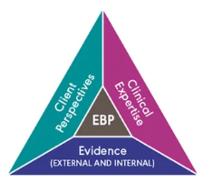
EBP
ASHA’s Model
Medical Model
EBP
37
Notes:
We’ve seen how this perspective expands our reach across the entire field—from voice to stuttering to neurodevelopmental disorders. But to truly embrace this shift, we need to look at the cornerstone of our practice: Evidence-Based Practice."
We’re all familiar with Evidence-Based Practice model, but I think as healthcare providers, we need to recognize our ASHA model is a pyramid, rather than a Venn diagram as in the medical community. Each side of the ASHA triangle model is not necessarily equal, nor would the medical Venn diagram. There can be a lot of different triangle shapes based on the expertise of a clinician, the known research and training, or perhaps the barriers a patient puts up about what treatment are willing to do - or are seeking.
As we look at the clinician’s expertise, we’re asked to rely on our training and professional experiences. Personally, I did not have training in myofunctional disorders beyond indirectly doing it in a graduate placement, and I was guided away from looking at tongue thrust and oral motor activities because they weren’t specific to making speech sounds for my school-based population. I didn’t realize how I needed specific muscles isolated, then activated to create molar stabilization, as evidenced by Pam Marshalla’s palatogram and how essential this is for a healthy swallow. The ‘clinical experience’ leg of my triangle, as well as anyone trained before 2020 would naturally be weaker in this area.

Slide 40
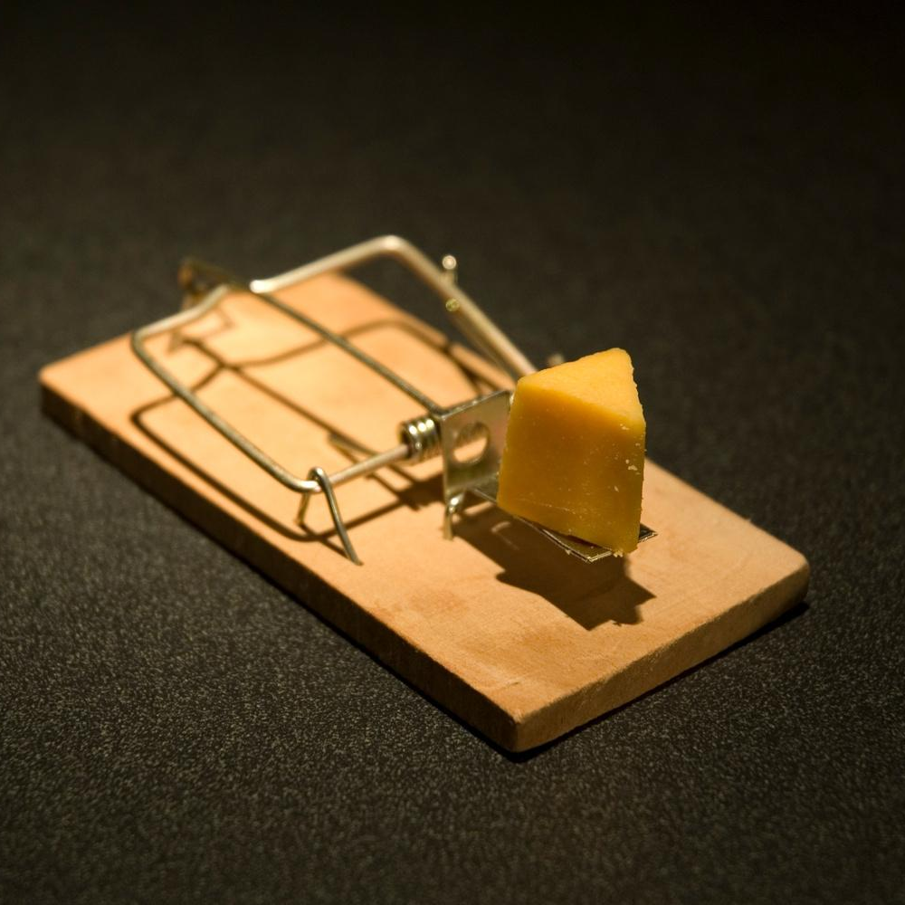
Watch the Ableist Trap!
“That’s just how they are”
38
Notes:
In working with my patients, they simply wanted to eliminate their communication disorder ASAP, and they largely trusted me to choose the ‘right’ method to do so. I developed a great toolbox of skills and became quite adaptable at applying these tools. But why were so many of my school-based kids in speech for YEARS, and several extending past a decade? I found myself and my colleagues having an Abelist perspective. The "Ableist perspective" is a viewpoint that discriminates in favor of able-bodied individuals. In a the SLPs clinical context, an Ableist perspective is a damaging belief system because it sees a patient's struggles as inherent, unchangeable deficits (i.e., "that's just how they are"); that cannot be fully corrected, which ultimately justifies a plateau in progress.
In most cases: that patient is just going to need to talk slower for the rest of their lives in order to coordinate their speech sounds or to remain fluent. We could justify it as “that’s just how they are” without any brain imaging or other clear diagnostic reason for why the patient struggled as they do - and forever will. But I was supposed to feel good I got them however far I did. But it didn’t and doesn’t feel good- and I’m getting more aware of the psycho-social impact it has on each person. I constantly hear from parents how their child is losing their leadership, is becoming more self-conscious about how they sound, is hesitant to participate or socialize, and I believe this has a huge impact on how much the child accesses, and how many opportunities the child is able to build from - I feel it vastly inhibits their potential and outcomes in life.
To look for the best evidence, use of Google Scholar offers an opportunity to search myofunctional disorders across professions. I’d advise against companies offering to summarize research for you as there is typically a bias. Through use of myofunctional therapy, I am able to diagnose, refer, treat, and dismiss a patient with fully healthy function in a matter of months; that is a vastly different time horizon. It reflects well on me as a clinician, but also as a field of speech-language pathologists. And frankly, dental hygienists are quick to use ‘speech sound disorders’ as a way to attract patients into their offices for “myofunctional disorders”, though swallowing is the root methodology of treatment. This puts patients at risk, and is an infringement on our scope of practice.

Slide 41


Plateaus are an opportunity to
re-evaluate what we may be missing
enhanced oral function assessments create stronger evaluations, faster progress, higher outcomes
39
Notes:
Let’s reframe how we view the clinical plateau. When a patient's progress stalls, it is incredibly easy for families to internalize that lack of progress as shame, while clinicians may instinctively default to blaming the family for "non-compliance." I challenge you to move past this defensive cycle- View these plateaus not as a failure, but as a critical Opportunity to Re-evaluate. This is the moment to investigate what we might be missing in our therapeutic approach, such as foundational issues like airway concerns or tongue restrictions.
By making this shift, SLPs can fully realize their Professional Power to drive substantial and lasting changes across both healthcare and educational settings, ultimately better serving the patients who need us most by focusing on functional impacts.

Slide 42
References
American Speech-Language-Hearing Association. (n.d.). Orofacial myofunctional disorders (Practice Portal). https://www.asha.org/practice-portal/clinical-topics/orofacial- myofunctional-disorders/
American Speech-Language-Hearing Association. (1989). Report: Ad hoc committee on labial-lingual posturing function. Asha, 31(11), 92–94.
American Speech-Language-Hearing Association. (1991). The role of the speech-language pathologist in the management of oral myofunctional disorders [Position Statement]. https://www.asha.org/policy/ps1991-00007/
American Speech-Language-Hearing Association. (1993). Orofacial myofunctional disorders: Knowledge and skills. Asha, 35(Suppl. 10), 21–23.
American Speech-Language-Hearing Association. (2016). Scope of practice in speech-language pathology [Scope of Practice]. https://www.asha.org/policy/sp2016-00343/
Baxter, R., & Merkel-Walsh, R. (2025). Cerebral palsy and ankyloglossia: Improved sleep, speech, swallowing, and breathing after tongue-tie release: A case series. Special Care in Dentistry, 45(3), Article e70046. https://doi.org/10.1111/scd.70046
Baxter, R., Merkel-Walsh, R., Baxter, B. S., Lashley, A., & Rendell, N. R. (2020). Functional improvements of speech, feeding, and sleep after lingual frenectomy tongue-tie release: A prospective cohort study. Clinical Pediatrics, 59(9-10), 885–892. https://doi.org/10.1177/0009922820928055
Besedovsky, L., Lange, T., & Born, J. (2012). Sleep and immune function. Pflügers Archiv - European Journal of Physiology, 463(1), 121–137. https://doi.org/10.1007/s00424-011-1044-0
Brown, B. (2006). Shame Resilience Theory: A Grounded Theory Study on Women and Shame. Families in Society: The Journal of Contemporary Social Services.
Burlea, Ș. L., Checheriţă, L. E., Stamatin, O., Văcaru, M., Sîrghe, A. E., Rudnic, I., Ilinca, D. A., Budu, V., Beldiman, M. A., Toma, V., Aminov, L., & Ciubară, A. (2025). Exploring Dyslexia Risk Through Psycholinguistic and Orofacial Correlates: Neurodevelopmental Insights Toward a Personalized Medicine Approach. Journal of personalized medicine, 15(8), 369. https://doi.org/10.3390/jpm15080369
Cappuccio, F. P., Cooper, D., D'Elia, L., Strazzullo, P., & Miller, M. A. (2011). Sleep duration predicts cardiovascular outcomes: a systematic review and meta-analysis of prospective studies. European Heart Journal, 32(12), 1484–1492. https://doi.org/10.1093/eurheartj/ehr007
Council for Clinical Certification in Audiology and Speech-Language Pathology. (2020). 2020 Standards for the certificate of clinical competence in speech-language pathology. https://www.asha.org/certification/2020-slp-certification-standards/
40

Slide 43
Council on Academic Accreditation in Audiology and Speech-Language Pathology. (2023). Standards for accreditation of graduate education programs in audiology and speech-language pathology. https://caa.asha.org/siteassets/files/2023-accreditation-standards-graduate-slp.pdf
D'Onofrio L. (2019). Oral dysfunction as a cause of malocclusion. Orthodontics & craniofacial research, 22 Suppl 1(Suppl 1), 43–48. https://doi.org/10.1111/ocr.12277
Ferrante, A., & Ferrante, A. (2015). Il problema del succhiamento del dito. Nuove interpretazioni e implicazioni terapeutiche [Finger or thumb sucking. New interpretations and therapeutic implications]. Minerva pediatrica, 67(4), 285–297.
Han, S.-H., Kim, M.-C., Choi, Y.-S., Lim, J.-S., & Han, K.-T. (2012). A study on the genetic inheritance of ankyloglossia based on pedigree analysis. Archives of Plastic Surgery, 39(4), 329–332. https://doi.org/10.5999/aps.2012.39.4.329
Klockars, T. (2007). Familial ankyloglossia (tongue-tie). International Journal of Pediatric Otorhinolaryngology, 71(8), 1321–1324. https://doi.org/10.1016/j.ijporl.2007.05.018
Maffei, M. F., Chenausky, K. V., Gill, S. V., Tager-Flusberg, H., & Green, J. R. (2023). Oromotor skills in autism spectrum disorder: A scoping review. Autism research : official journal of the International Society for Autism Research, 16(5), 879–917. https://doi.org/10.1002/aur.2923
Marshalla, P. (2020). The Marshalla guide: A topical anthology of speech movement techniques for motor speech disorders and articulation deficits. Marshalla Speech and Language.
Martins, M. F. L., Eckeli, A. L., Stelzer, F. G., Valera, F. C. P., & Folha, G. A. (2025). Vocal and Orofacial Myofunctional Characteristics of Individuals with Obstructive Sleep Apnea. Sleep science (Sao Paulo, Brazil), 18(4), e397–e403. https://doi.org/10.1055/s-0045-1813731
Merkel-Walsh, R., & Carey, D. (n.d.). An open letter to The Informed SLP. Robyn Merkel-Walsh. https://www.robynmerkelwalsh.com/_files/ugd/d8d143_c8ca957cdeb547b6b4699b827e8f14e9.pdf
Merkel-Walsh, R., Carey, D., Burnside, A., Grime, D., Turkich, D., Tseng, R. J., & Smart, S. (2025). Effectiveness of Orofacial Myofunctional Therapy for Speech Sound Disorders in Children: A Systematic Review. International Journal of Orofacial Myology and Myofunctional Therapy, 51(1), 4. https://doi.org/10.3390/ijom51010004
Mills, C. S. (2011). International Association of Orofacial Myology history: Origin - background - contributors. International Journal of Orofacial Myology, 37(1), 5–25 .
Sackett, D. L., Rosenberg, W. M., Gray, J. A., Haynes, R. B., & Richardson, W. S. (1996). Evidence based medicine: what it is and what it isn't. BMJ (Clinical research ed.), 312(7023), 71–72. https://doi.org/10.1136/bmj.312.7023.71
Summersgill, I., Nguyen, G., Grey, C., Norouz-Knutsen, L., Merkel-Walsh, R., Katzenmeir, C., Rafii, B., & Zaghi, S. (2023). Muscle Tension Dysphonia in Singers and Professional Speakers with Ankyloglossia: Impact of Treatment with Lingual Frenuloplasty and Orofacial Myofunctional Therapy. International Journal of Orofacial Myology and Myofunctional Therapy, 49(1), 1-8. https://doi.org/10.52010/ijom.2023.49.1.1
Walker, M. P., & Stickgold, R. (2006). Sleep, memory, and plasticity. Annual Review of Psychology, 57, 139–166. https://doi.org/10.1146/annurev.psych.56.091103.070308
Walker, M. P., & van der Helm, E. (2009). Overnight therapy? The role of sleep in emotional brain processing. Psychological Bulletin, 135(5), 731–748. https://doi.org/10.1037/a0016570
Xie, L., Kang, H., Xu, Q., Chen, M. J., Liao, Y., Thiyagarajan, M., O'Donnell, J., Christensen, D. J., Nicholson, C., Iliff, J. J., Takano, T., Deane, R., & Nedergaard, M. (2013). Sleep drives metabolite clearance from the adult brain. Science, 342(6156), 373–377. https://doi.org/10.1126/science.1241224
41

